Slide 1
MODEL-1
Front view
Top view
Side view
Back view

Slide 2
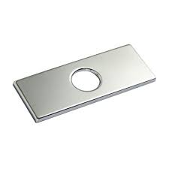
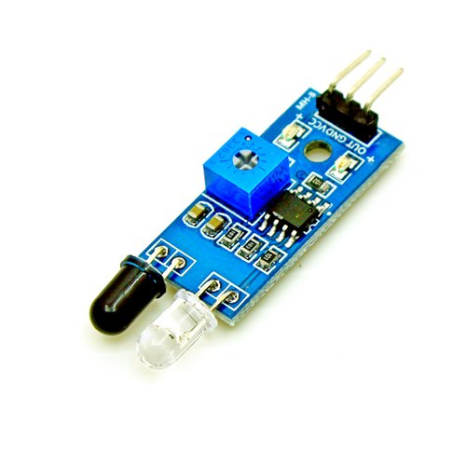

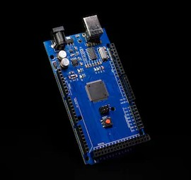
All the parts are connected to Arduino mega. And it takes the command from the switches.
SECTIONAL view

Slide 3
SUBSYSTEM
Switches
INPUT
Spice container
MIXING
Opening and closing Lid
Mixing container
Speaker and light
OUTPUT
Out-take

